Slide 1
Pupil Expanders – Is a Hexagon better than Square?
6.5 mm
Side
6.5 mm
Short Diagonal
Questions:
Which is easier to insert into the Anterior Chamber ?
Which is easier to manipulate in Anterior Chamber ?
Dr. Suven Bhattacharjee

Slide 2
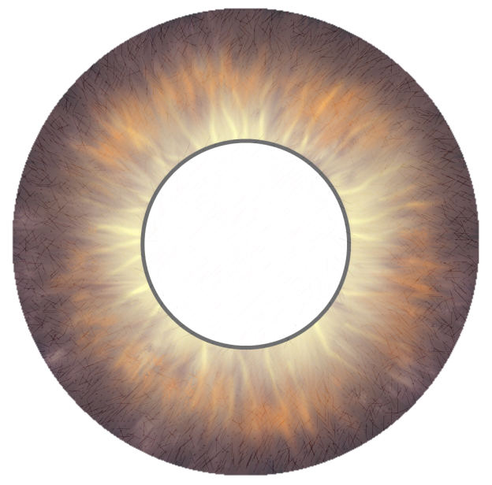
Geometric Analysis – Insertion - Watch if elongated device enters AC completely
Square
Hexagon
6.5 mm
3.75 mm
6.5 mm
3.75 mm
6.5 mm
6.5 mm
6.5 mm
6.5 mm
3.75 mm
3.75 mm
3.75 mm
Upto 13 mm
Upto 11.25 mm
11.5 mm
Dr. Suven Bhattacharjee

Slide 3
Geometric Analysis – Manipulation in AC – Watch Corner to AC Angle distance
3.75 mm
6.5 mm
9.2 mm
7.5 mm
6.5 mm
Square
Side = 6.5 mm
Incircle dia = 6.5 mm
Circumcircle dia = 9.2 mm
Hexagon
Short diagonal = 6.5 mm
Incircle dia = 6.5 mm
Circumcircle dia = 7.5 mm
11.5 mm
3.75 mm
6.5 mm
9.2 mm
7.5 mm
6.5 mm
Dr. Suven Bhattacharjee

Slide 4
The Square may appear to provide greater exposure but …….
Both a Square with a 6.5 mm side and a Hexagon with a 6.5 mm short diagonal accommodate a 6.5 mm diameter incircle.
The incircle is the activity area - the area outside the incircle at the corners is wasted space
When inserted through a small incision the longer diagonal of the elongated Square precludes its complete insertion into the anterior chamber in a single pass.
The circumcircle of the Square is much larger than that of the Hexagon. The corners of the square are more likely to injure the angle of the anterior chamber during manipulations.
The Hexagon is geometrically superior to the Square !

